Slide 1

NPTEL
Applied Accelerated Artificial Intelligence
Week 06 · Segment 1
Large Language Models: Foundations for Optimization and Fine-tuning
Instructor: Dr. Satyajit Das
Department of Computer Science and Engineering
Indian Institute of Technology Guwahati, Assam, India
Segment 1 sets the conceptual base for the remaining Week 6 lectures: mixed precision, memory optimization, transfer learning, and PEFT/LoRA.
Notes:
[Sources]
- User-provided course template slide deck and week-6 syllabus for layout and scope.
- Vaswani et al., Attention Is All You Need, NeurIPS 2017.
- Brown et al., Language Models are Few-Shot Learners, NeurIPS 2020.
[/Sources]

Slide 2
Why PEFT exists: the cost structure of LLM adaptation
Week 06 · Segment 5
The engineering problem
Memory and storage burden per task
For a new task or domain, a naive full fine-tune duplicates training state for the whole model. As model size grows, that means more gradient memory, more optimizer state, more checkpoint storage, and more deployment copies.
Trainable params
Optimizer state
What PEFT changes
Task checkpoint
PEFT freezes the backbone and trains only a small set of extra parameters. That reduces trainable state dramatically and makes it easier to keep one shared base model while swapping compact task adapters.
Frozen base copy
Rule of thumb
Why LoRA became the default
If the task can be solved with prompts or retrieval, do that first. If you need parameter updates, PEFT is usually the first adaptation route to try; full fine-tuning is the escalation path, not the default.
LoRA preserves the familiar backpropagation workflow while shrinking trainable state to a small low-rank update. That makes it simple to implement, easy to checkpoint, and friendly to deployment as a compact adapter file.
Frozen base
Frozen base
Frozen base
Frozen base
Full FT
Selective FT
LoRA
QLoRA
Interpretation
The largest savings come from not training, storing, and shipping full per-task copies of the backbone. QLoRA then compresses the frozen base further so that the same LoRA idea can fit tighter hardware budgets.
Figure redrawn for teaching from [1], [2], [3], [6], [7]. Not to scale; stack heights show relative engineering burden per task.
3
Notes:
[Sources]
- Hu et al., LoRA: Low-Rank Adaptation of Large Language Models, arXiv:2106.09685, 2021.
- Dettmers et al., QLoRA: Efficient Finetuning of Quantized LLMs, arXiv:2305.14314, 2023.
- Houlsby et al., Parameter-Efficient Transfer Learning for NLP, ICML 2019.
- Hugging Face PEFT LoRA developer guide, accessed 2026.
- Hugging Face PEFT quantization guide, accessed 2026.
[/Sources]

Slide 3
The PEFT landscape: where LoRA fits and why it dominates LLM practice
Week 06 · Segment 5
Adaptation continuum
Prompting / RAG
Prompt / Prefix tuning
Adapters / IA3
LoRA family
QLoRA / quantized LoRA
Zero trainable weights
Fastest to try
Soft prompts or prefixes
Smallest PEFT footprint
Extra modules or gating
More structure, some overhead
Low-rank weight updates
Best default for many LLMs
LoRA on a compressed base
Best when memory is tight
More trainable capacity / adaptation strength →
More implementation complexity / deployment care →
Prompt methods
Adapters / prefixes
Why LoRA sits in the middle
Why QLoRA matters
Use first when the model already knows the task and you mainly need better instructions, better context packing, or external retrieval.
More explicit task-specific structure, but often more architecture-specific engineering than LoRA and sometimes more inference overhead.
It captures useful weight updates without retraining the full model, introduces little deployment friction, and works naturally with modern transformer stacks.
QLoRA keeps the LoRA training story but shrinks the frozen base further so much larger backbones fit on limited GPU memory.
Figure synthesized from [1], [2], [3], [4], [5], [6]. Position indicates a practical continuum, not a strict superiority ranking.
4
Notes:
[Sources]
- Hu et al., LoRA: Low-Rank Adaptation of Large Language Models, arXiv:2106.09685, 2021.
- Dettmers et al., QLoRA: Efficient Finetuning of Quantized LLMs, arXiv:2305.14314, 2023.
- Houlsby et al., Parameter-Efficient Transfer Learning for NLP, ICML 2019.
- Li and Liang, Prefix-Tuning: Optimizing Continuous Prompts for Generation, ACL 2021.
- Lester et al., The Power of Scale for Parameter-Efficient Prompt Tuning, EMNLP 2021.
- Hugging Face PEFT LoRA developer guide, accessed 2026.
[/Sources]

Slide 4
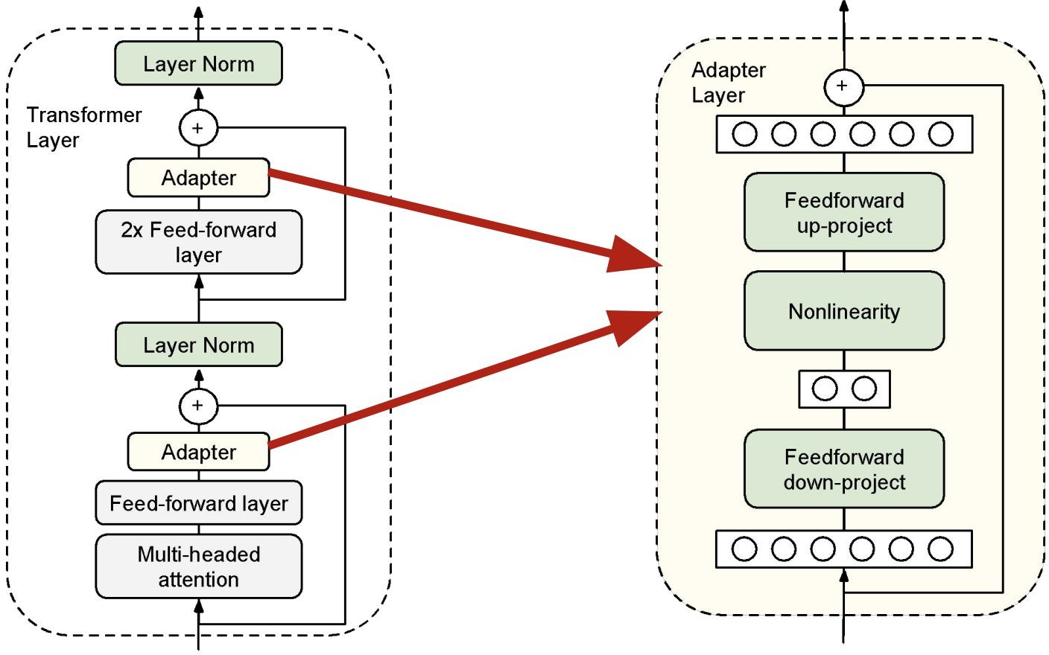
Why PEFT exists: the cost structure of LLM adaptation
Week 06 · Segment 5
Adapter (Houlsby et al. 2019)
Figure redrawn for teaching from [1], [2], [3], [6], [7]. Not to scale; stack heights show relative engineering burden per task.
3
Notes:
[Sources]
- Hu et al., LoRA: Low-Rank Adaptation of Large Language Models, arXiv:2106.09685, 2021.
- Dettmers et al., QLoRA: Efficient Finetuning of Quantized LLMs, arXiv:2305.14314, 2023.
- Houlsby et al., Parameter-Efficient Transfer Learning for NLP, ICML 2019.
- Hugging Face PEFT LoRA developer guide, accessed 2026.
- Hugging Face PEFT quantization guide, accessed 2026.
[/Sources]

Slide 5
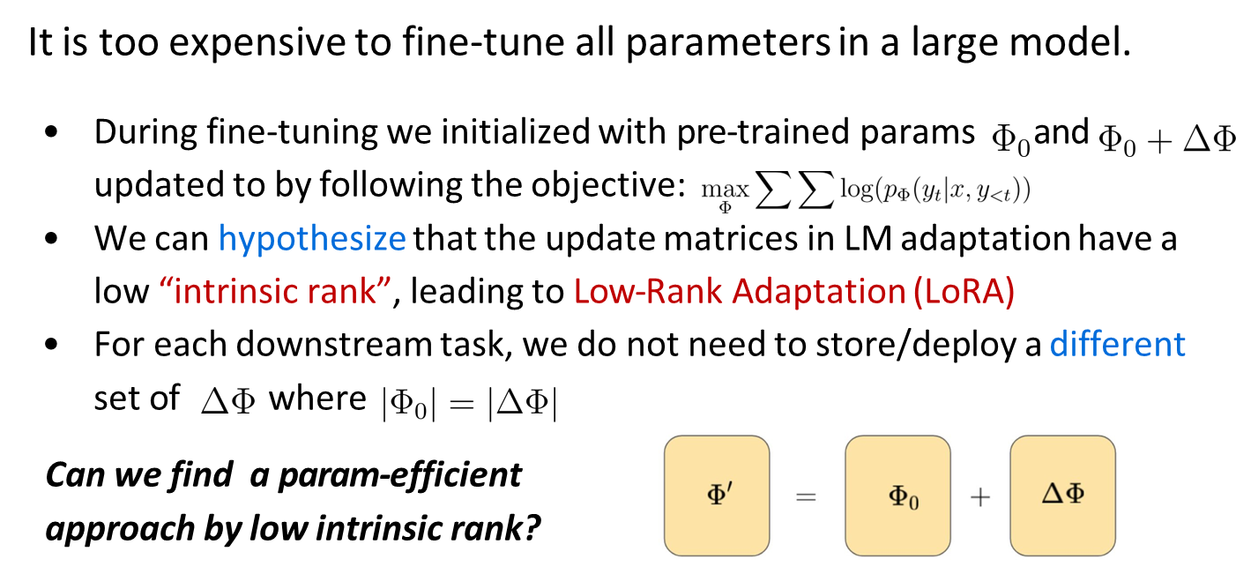
LoRA intuition and math: a frozen weight plus a trainable low-rank update
Week 06 · Segment 5
Figure redrawn for teaching from [1] and [6].
5
Notes:
[Sources]
- Hu et al., LoRA: Low-Rank Adaptation of Large Language Models, arXiv:2106.09685, 2021.
- Hugging Face PEFT LoRA developer guide, accessed 2026.
[/Sources]

Slide 6
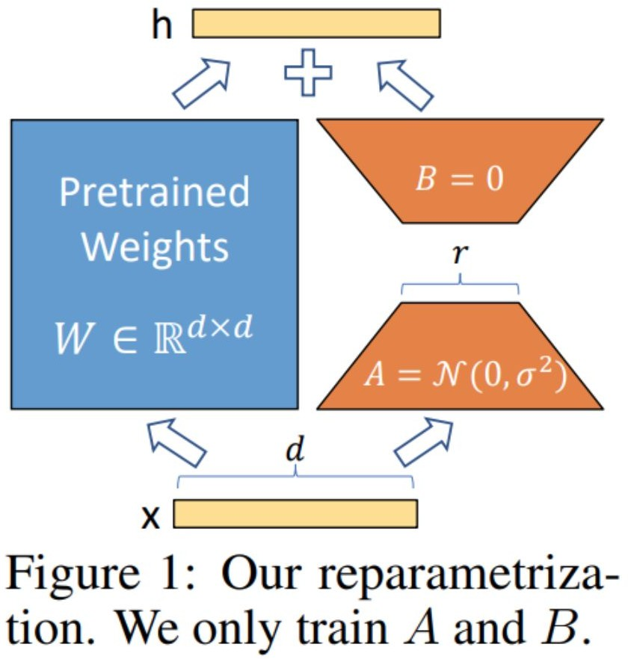
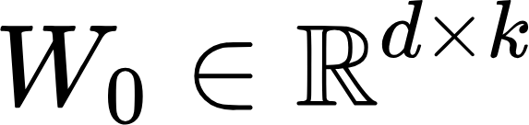


LoRA intuition and math: a frozen weight plus a trainable low-rank update
Week 06 · Segment 5
Previous study shows that
Pre-trained LLMs have a “low intrinsic dimension”
LLMs can still learn efficiently despite a low-dim reparametrization
During training: for pre-trained weight , is fixed
During inference:
Figure redrawn for teaching from [1] and [6].
5
Notes:
[Sources]
- Hu et al., LoRA: Low-Rank Adaptation of Large Language Models, arXiv:2106.09685, 2021.
- Hugging Face PEFT LoRA developer guide, accessed 2026.
[/Sources]

Slide 7
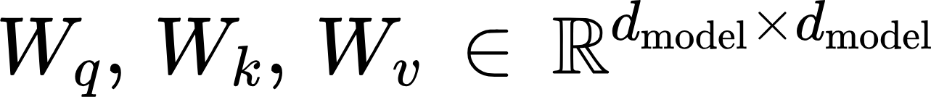
LoRA intuition and math: a frozen weight plus a trainable low-rank update
Week 06 · Segment 5
Applying LoRA to Transformer
In principle, LoRA can be applied to any weight matrices in DL
LoRA’s original paper only study changing the attention weights
Benefits
No need to track optimizer state for frozen params, smaller checkpoint size (GPT-3: 1.2TB [before] → 350GB [training] → 35MB [inference])
No additional inference latency
speed up during training
Figure redrawn for teaching from [1] and [6].
5
Notes:
[Sources]
- Hu et al., LoRA: Low-Rank Adaptation of Large Language Models, arXiv:2106.09685, 2021.
- Hugging Face PEFT LoRA developer guide, accessed 2026.
[/Sources]

Slide 8
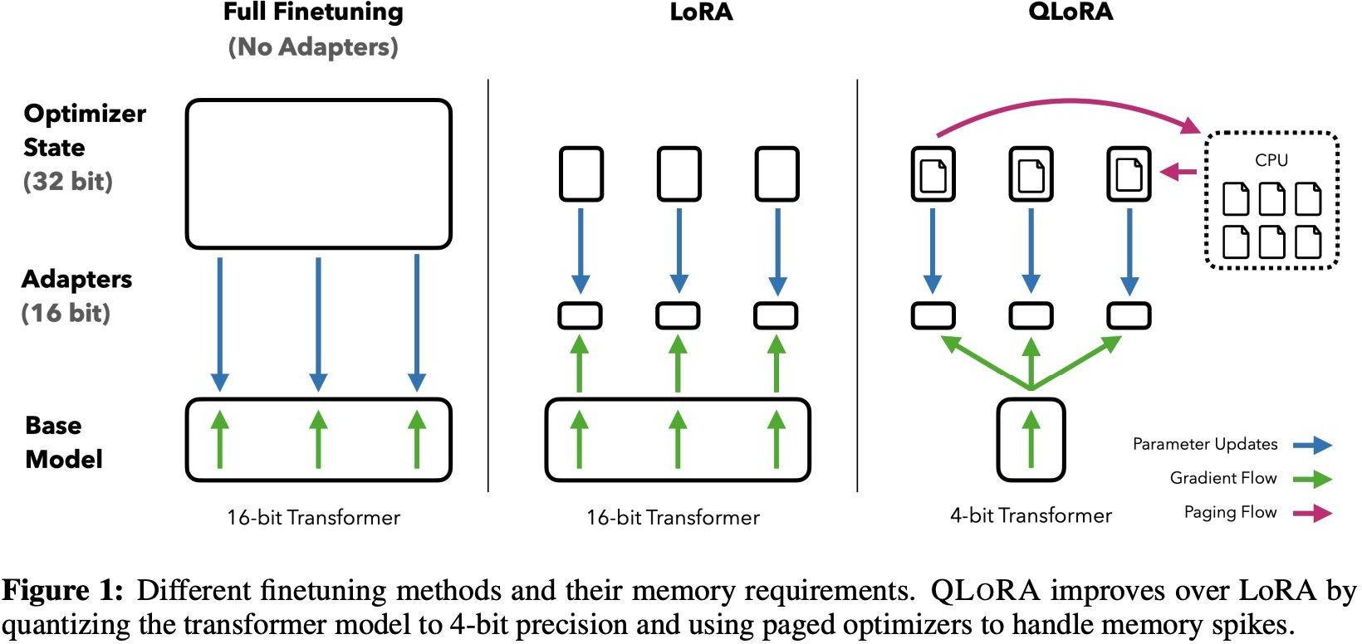
QLoRA
Week 06 · Segment 5
QLoRA = Quantized pre-train LLM + LoRA
Major innovations:
  4-bit Normal Float
  Double Quantization
  Page Optimizer
4-bit storage data type
Bfloat16 computational data type
Reduces the average memory requirements of fine-tuning a 65B parameter model from 780GB of GPU memory to 48GB on a single GPU.
Preserving performance compared to a 16- bit fully fine-tuned baseline.
Figure redrawn for teaching from [1] and [6].
5
Notes:
[Sources]
- Hu et al., LoRA: Low-Rank Adaptation of Large Language Models, arXiv:2106.09685, 2021.
- Hugging Face PEFT LoRA developer guide, accessed 2026.
[/Sources]

Slide 9
Where LoRA adapters are inserted in a transformer block
Week 06 · Segment 5
Common first choice
Transformer block
Architecture-specific names
For decoder-only LLMs, start by adapting attention projections. q_proj and v_proj are a classic minimal starting point; q/v/o or all attention projections are common when you need more capacity.
The concept is stable even when module names differ. One family may use q_proj/v_proj/o_proj; another may expose c_attn and c_proj or merged QKV projections.
q
k
v
o
Self-attention projections: q_proj, k_proj, v_proj, o_proj
QLoRA-style default
Attention softmax + combine heads
Practical default
When model memory is the bottleneck and you want a stronger adapter, target "all-linear" so LoRA attaches to attention and MLP linear layers throughout the block.
If you are unsure which names to target, inspect model.named_modules() and identify the linear layers responsible for attention and MLP projections first.
up
gate
down
MLP projections: gate/up/down or fc1/fc2
What not to expect
Why these layers
LoRA does not usually target norms, residual additions, or softmax itself. Those operations are numerically important, but not where low-rank weight updates naturally live.
These layers dominate the representational transformations that matter most for task behavior, so low-rank updates here often give the biggest benefit per trainable parameter.
Norms, residuals, output state
Figure synthesized from transformer block structure in [1], LoRA targeting guidance in [2], [6], [7].
6
Notes:
[Sources]
- Hu et al., LoRA: Low-Rank Adaptation of Large Language Models, arXiv:2106.09685, 2021.
- Dettmers et al., QLoRA: Efficient Finetuning of Quantized LLMs, arXiv:2305.14314, 2023.
- Hugging Face PEFT LoRA developer guide, accessed 2026.
- Hugging Face PEFT quantization guide, accessed 2026.
[/Sources]

Slide 10
Choosing LoRA hyperparameters and training settings
Week 06 · Segment 5
Rank r
Alpha / scaling
Target modules
Dropout
Higher r increases adaptation capacity but also trainable parameters and memory. Start small; only raise it if the baseline underfits.
lora_alpha controls the effective update scale. Keep it consistent with rank and learning rate; too aggressive a scale can destabilize training.
The target set matters as much as rank. A small rank over the right modules often beats a large rank over the wrong modules.
LoRA dropout is a regularization tool. Use modest values when data is small/noisy; use zero or near zero when data is large and clean.
Practical first-run defaults
Conceptual effect of rank
Scenario
Target modules
Typical r
Notes
Trainable
params
Trainable params ∝ r
Conservative first try
q_proj, v_proj
8–16
Good when you want a cheap baseline
Stronger attention-only
q, k, v, o
16–32
Use when minimal q/v underfits
QLoRA-style adaptation
all-linear
16–64
Common when the base is quantized
Task fit improves then saturates
Very small dataset
minimal targets
4–16
Reduce capacity before blaming precision
Do not overtune the adapter first
Quantized route caveat
Evaluate the right thing
Before sweeping many ranks and target sets, validate data formatting, prompt template, loss masking, and evaluation protocol. Many “LoRA problems” are really data or objective problems.
On a quantized base, memory may push you to QLoRA, but adapter quality still depends heavily on choosing target modules, optimizer settings, and a clean instruction format.
For instruction models, inspect both quantitative metrics and actual generations. A rank that looks fine on loss alone may still miss format-following or domain vocabulary behavior.
small
medium
high
Adapter capacity / fit
Figure synthesized from [1], [2], [6], [7]. Defaults are starting points, not universal optima.
7
Notes:
[Sources]
- Hu et al., LoRA: Low-Rank Adaptation of Large Language Models, arXiv:2106.09685, 2021.
- Dettmers et al., QLoRA: Efficient Finetuning of Quantized LLMs, arXiv:2305.14314, 2023.
- Hugging Face PEFT LoRA developer guide, accessed 2026.
- Hugging Face PEFT quantization guide, accessed 2026.
[/Sources]

Slide 11
Thank You

